Slide 1


FRT & CERT APP
First Response & CERT management tool
Supervisor - Dr. Unkelos-Shpigel Naomi
Yuval Badihi & Sharon Mor

Slide 2
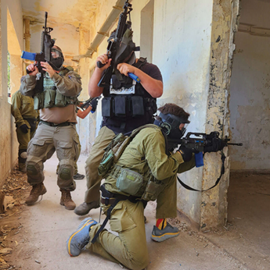

First Response Team (FRT)
Frontline responders providing immediate action during crises.
Who: Armed local residents
Mission: Rapid response to emergency scenes
Structure: Divided into small units
Tasks: Patrolling and gatekeeping to ensure area security

Slide 3

Community Emergency
Response Teams (CERT)
Community volunteers trained for initial crisis response.
Who: Local residents
Mission: Enhances community resilience and emergency readiness
Structure: Health, Education, Logistics, and Spokesperson teams
Activities: Manage injuries, host educational events, and oversee logistics in crises

Slide 4

Need for Rapid First Response
In emergencies, the army and other traditional systems like police and fire services often face delays, which can be critical.
Rapid first response is essential in cases such as:
Increase of Terror Attacks
Natural Disasters
Incidents within the community

Slide 5
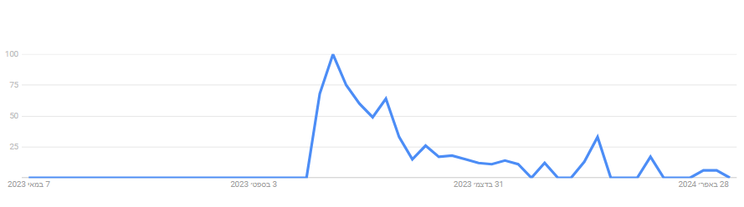

Annual Trends Search for 'כיתת כוננות' on Google Trends
07.05.2023
03.10.2023
31.10.2023
28.04.2024
07.10.2023

Slide 6






The Problem
First response teams lack adequate management tools.
Consequences: Leads to communication breakdowns, delays, and inefficiencies.
Devastating Outcomes: These issues can have devastating consequences during emergencies.

Slide 7

Existing FRT Management Tools
 | GPS Tracking | Smart Map | PTT | Chat | SOS Alarm | Groups | Task Assignment
Avuka | ✔ | ✔ | ✔ | ✔ | ✔ | ✔
AVIA | ✔ | ✔ |  | ✔ | ✔ | ✔
Zello |  |  | ✔ | ✔ | ✔ | ✔
WhatsApp |  |  |  | ✔ |  | ✔

Slide 8



Interviews
Emphasized the need for a system that connects operational teams effectively and facilitates communication.
“During the events of 07.10.2023, effective communication between the settlement FRTs could save lives.”
Muli Shpigel Architect, Director of Engineering and Planning Department, the settlements in the Golan
Highlighted the importance of user-friendly tech with role-specific functionalities for efficient task management, and the necessity of a strict hierarchy with appropriate permissions.
“It's crucial our tools are intuitive. during a crisis, no one should struggle with complex interfaces.”
Hagit Geva, Itamar Cohen
Head of & Deputy Head of the CERT in Givat Yoav settlement.
Highlighted the necessity for simple UI and a technology that functions without GPS, and that they don’t want to replace their existing Walkie Talkies.
“Since the blackout on 7.10, we've realized the necessity for technology that works independently of GPS connection”
Roee Tavor
Head of CERT in Kanaf settlement

Slide 9

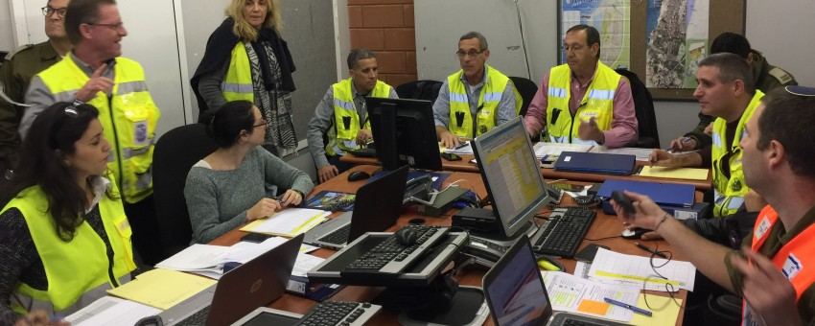

Our Solution
Advanced Web and Mobile Application for First Response Teams
Optimized Communication
Operational Efficiency
Exceptional User Interface and Accessibility
Notes:
Advanced Web and Mobile Application for Emergency Response Teams
Optimized Communication: Tailored to enhance coordination among first and community emergency response teams, especially in high-risk and recently impacted areas.
Operational Efficiency: Streamlines processes to improve response times and effectiveness, with a complex web application for deep logic operations and a simpler, intuitive mobile app for on-the-go accessibility.
Exceptional User Interface and Accessibility: Committed to delivering a user-friendly experience that is accessible and inclusive for all users, ensuring efficient operation across devices.
Comprehensive Feature Set:
Task Management: Enables assigning, tracking, and updating tasks efficiently.
Interactive Map: Provides real-time geographical data for strategic planning and response.
Roles and Permissions: Ensures information security by assigning specific capabilities and access based on user roles.
Adaptable Views: Allows entities like Regional Councils to monitor activities across different settlements.
Message Board: Facilitates effective communication and information sharing among team members.
Reports Page: Archives and allows easy retrieval of past reports for review and analysis.
Alarm and Event Systems: Enhances response capabilities with customizable alerts and a structured event management framework.

Slide 10











Structure Diagram
Golan Regional Council
Givat Yoav Settlement
Kanaf Settlement
FRT
FRT
Health
Logistics

Slide 11






Our App in a Nutshell
Task Management
Roles & Permissions
Event Management
Alarms System
Interactive Map
Activity Log

Slide 12

Main Functional Requirements
Users system: Login & register
Groups: Create and Join a group
Alerts: Starting an alarm
Communication: Start a chat and see events history
Map: Interactive map with location, marking and sectoring functionality
Tasks: Create and assign a task
Notes:
Advanced Web and Mobile Application for Emergency Response Teams
Optimized Communication: Tailored to enhance coordination among first and community emergency response teams, especially in high-risk and recently impacted areas.
Operational Efficiency: Streamlines processes to improve response times and effectiveness, with a complex web application for deep logic operations and a simpler, intuitive mobile app for on-the-go accessibility.
Exceptional User Interface and Accessibility: Committed to delivering a user-friendly experience that is accessible and inclusive for all users, ensuring efficient operation across devices.
Comprehensive Feature Set:
Task Management: Enables assigning, tracking, and updating tasks efficiently.
Interactive Map: Provides real-time geographical data for strategic planning and response.
Roles and Permissions: Ensures information security by assigning specific capabilities and access based on user roles.
Adaptable Views: Allows entities like Regional Councils to monitor activities across different settlements.
Message Board: Facilitates effective communication and information sharing among team members.
Reports Page: Archives and allows easy retrieval of past reports for review and analysis.
Alarm and Event Systems: Enhances response capabilities with customizable alerts and a structured event management framework.

Slide 13
Main Non-Functional Requirements
Availability: Three-nines availability (99.9%) - no more than ~9 hours downtime per year
Security: Encrypting all chats and not saving PII (Personal Identifiable Information)
Performance: Handle up to 10,000 users simultaneously without performance degradation
Maps: Google Maps, Leaflet, Mapbox, OpenLayers

Slide 14
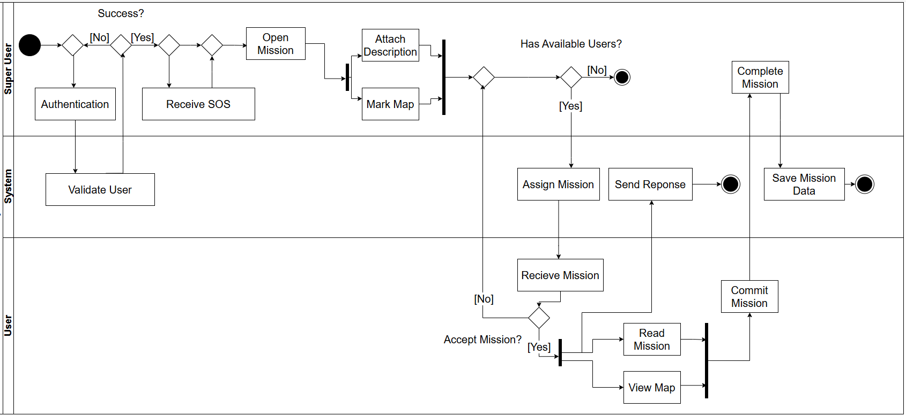


Activity Diagram

Slide 15
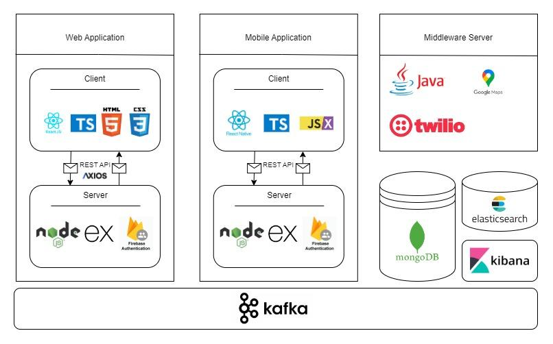

Architecture

Slide 16
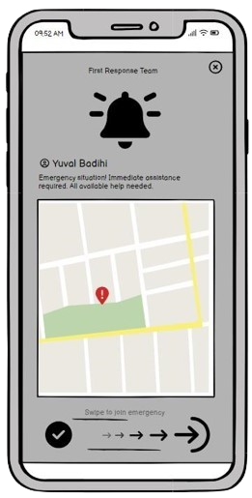
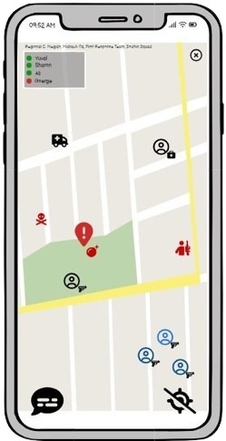
Mobile
Application Interface

Slide 17
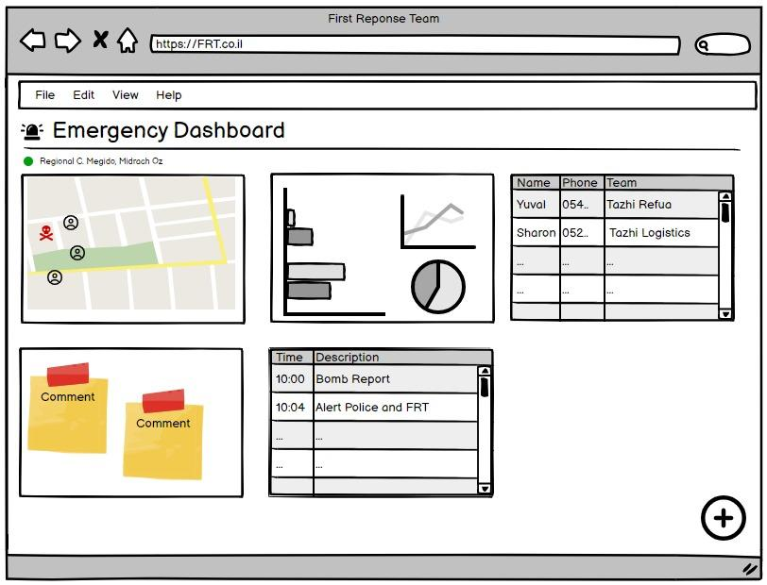
Web Application
Interface

Slide 18



Expected Achievements
Enhanced Coordination
Reliable Functionality Offline
Dynamic Role-Based Access
Good User-Friendly Design (high CSAT & SuS scores)

Slide 19

How we plan on measuring success
We plan to maintain close relationships with users, gathering their feedback during development and post-launch to enhance our offerings.
BI Events - more than 80% coverage
SUS (System Usability Scale) - grade higher than 85
CSAT (Customer Satisfaction Score) - grade higher than 90
Notes:
BI Events - Key activities within our system where data is collected and analyzed to improve decision-making
SUS (System Usability Scale) - A tool to evaluate the usability of our product through standardized questionnaires.
CSAT (Customer Satisfaction Score) - A metric assessing customer satisfaction with our product or service through quick surveys

Slide 20



Challenges
Data Synchronization
Interface Simplicity vs. Feature Richness
Scalability
React Native
Notes:
Data Synchronization: Ensuring seamless sync across devices in fluctuating network conditions.
Interface Simplicity vs. Feature Richness: Balancing a simple user interface with the complex functionalities needed by different teams.
Scalability: Preparing the system to handle increasing amounts of data and users without performance loss.
Tech: React Native - new to us, Deployment to both IOS and Android

Slide 21



Thank You Questions ?

